Slide 1
ABC RESTAURANT REPORT

Slide 2
COMPANY OVERVIEW
Mission Statement
Objective
Location
Business Model
SWOT Analysis
CHARTS
Competitor Analysis
In-Demand Marketing Strategies
Conclusion

Slide 3
COMPANY OVERVIEW FOR QSR BUSINESS
MISSION STATEMENT :
Aim is to provide authentic meal for customers near and surrounding regions.
We want people to love what they are eating.
We believe in building friendly community atmosphere with streamlined service.
Keys to Success :
Offering a unique differentiated menu
Ability to control stock on hand
Proximity to key markets
Effective Quality Control
OBJECTIVE :
To establish a presence as a successful local fast food outlet and gain a market share in BTM Layout’s fast food industry.
To provide quality meals at reasonable prices with exemplary service.

Slide 4

Location
ABC Restaurant is situated near BTM Layout, Bangalore.
The location is selected in order to serve the middle class section of society living in the area.
The target customers are the College going youth and office going people who often opt for a healthy fast food option in their busy day-to-day lives.
The Restaurant focuses on the Concentrated Marketing concept as it has limited resources.
The location provides ease of parking and in turn convenience to customers.
Location for every restaurant concept plays an important role in every business.
While selecting the location, it is better to choose a place where people visit with the mindset to consume and enjoy the company of their near and dear ones.
Selection of location should not force people to take the pains to reach the outlet.
Crowded areas like high-street, railway stations, airport lounges are the most preferred location for a fast food/ QSR business.

Slide 5
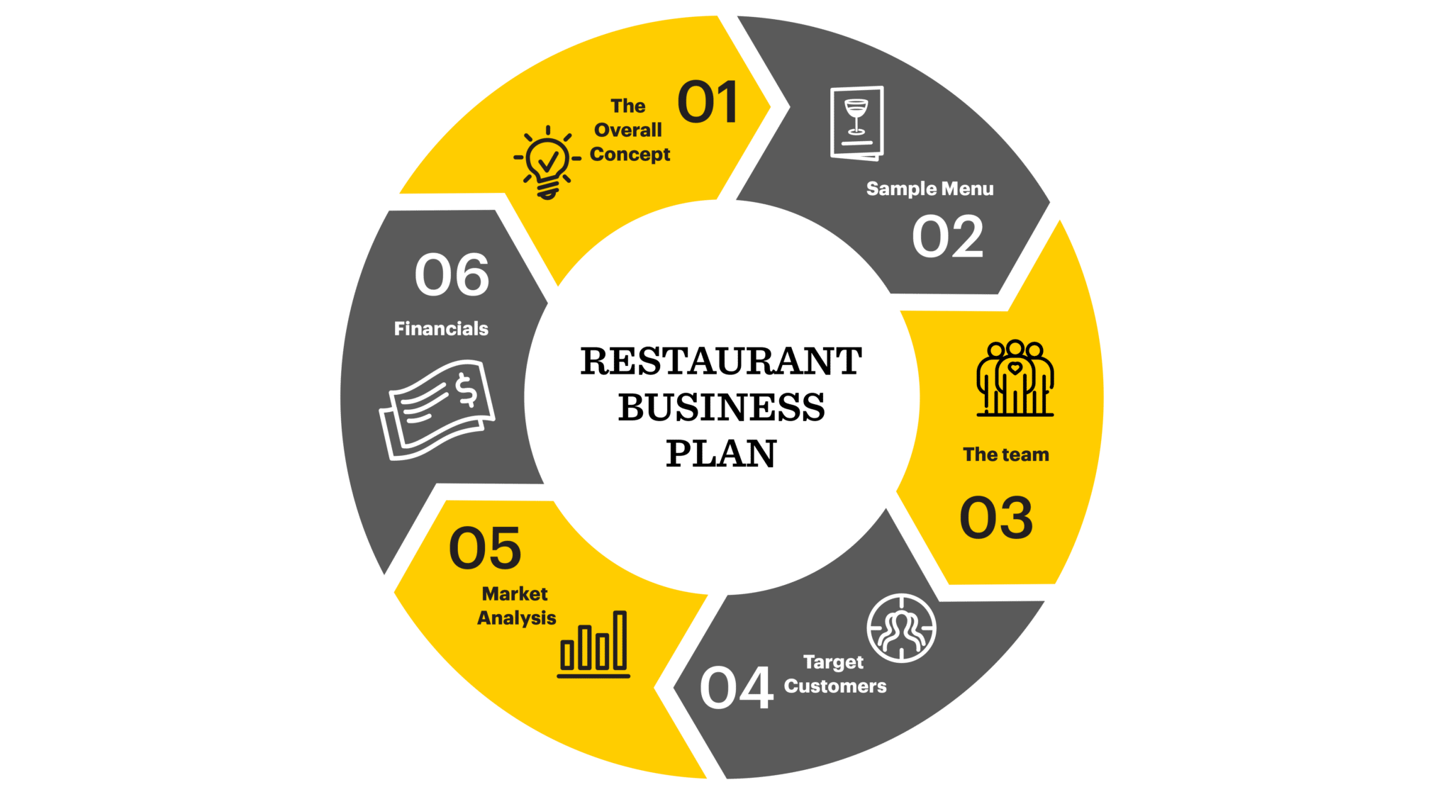
ABC RESTAURANT BUSINESS MODEL
CONCEPT
MENU
MARKET ANALYSIS
FINANCIALS
HOW TO IMPROVE PROFIT MARGIN

Slide 6
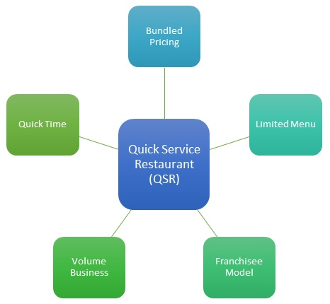
1. CONCEPT
The concept behind a restaurant business especially a QSR ( Quick Service Restaurant business) is to generate profit by providing quality service to its customers and to target the products that are quick to deliever.

Slide 7
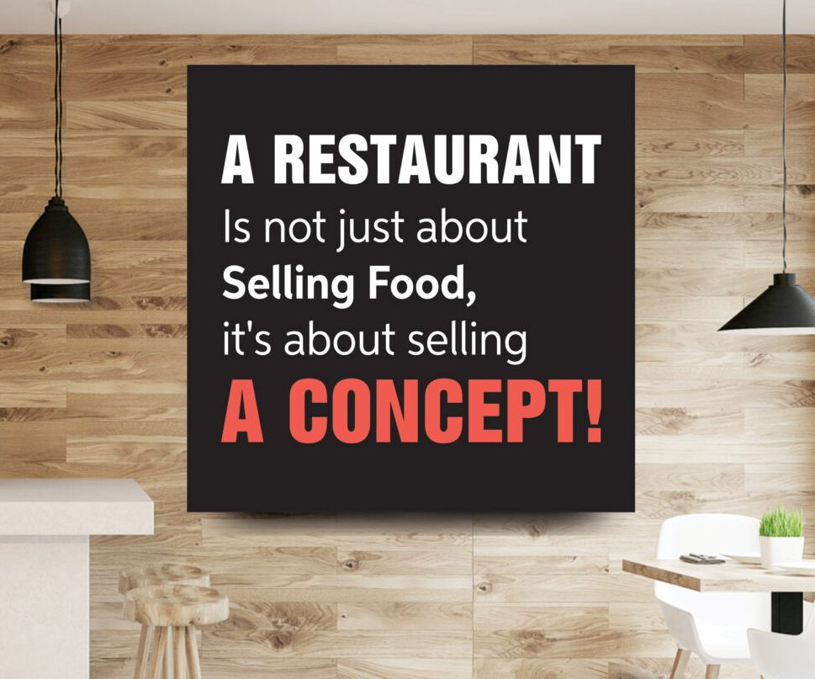
Key Points adding up to the CONCEPT of a QSR
1. A Restaurant with trendy fast food
2. Smaller and Niche Menu Offerings
3. Opting for an Easy-to-Operate Model
4. Choose Location Where People Walk-In to Eat
5. A Targeted Marketing Plan

Slide 8
MENU
VEG ITEMS
Veg Biryani
Maggie
Veg Burger
Aloo Tikki Chat
Masala Dosa
Veg Chowmine
Pani Puri
Aloo Puri
Veg Country Pizza
Aloo paratha
Paneer paratha
Onion paratha
Gobi paratha
Mushroom Chilli
Paneer Tikka
Veg Grill Sandwich
Paneer Grill Sandwich
Paneer Roll
Shahi Paneer Masala
Veg Paneer Pizza
Veg Hawaiian Pizza
Paneer Manchurian
Butter Roti
Kulcha Naan
Parotta
Plain Roti

Slide 9
MENU
Chicken Roll
Egg Roll
Tawa chicken roll
Chicken Grill Sandwich
Barbequed Chicken Pizza
Hyderabadi Mutton Biryani
Chicken 65 Dry
Egg Manchurian
NON-VEG ITEMS
Chicken Biryani
Egg Bhujia
Omlets with Bread Toast
Chicken Kabab
Maggi Omelette Noodles
Chicken Tikka

Slide 10
MENU
BEVERAGES
Mini Falooda
Royal Falooda
Arabian Falooda
Kulfi Falooda
Rose Falooda
Strawberry Tea Soda
Cream Berry Soda
Black Currant Tea Soda
Serial Kiwi Soda
Ginger Pineapple Punch
Fruit Punch
Mirchi Citrus
Ginger Cooler
Mint Soda
Pink Mango
Sunrise Delight

Slide 11
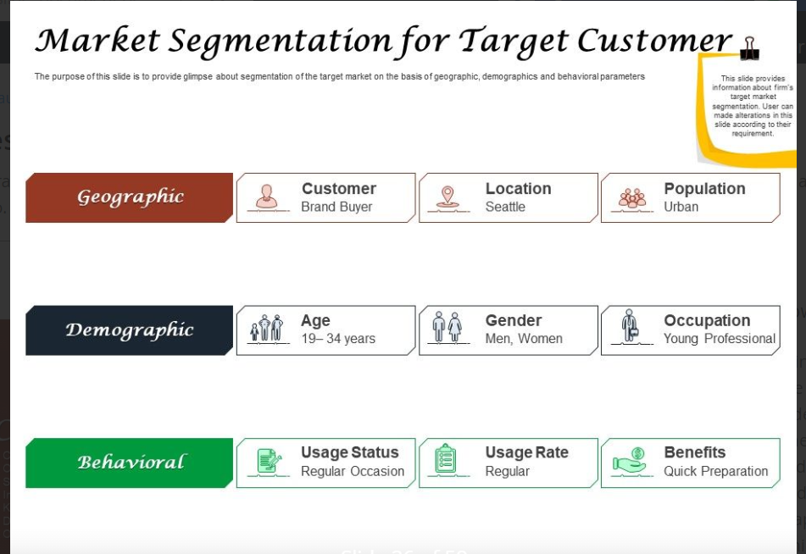
MARKET ANALYSIS
FEW IMPORTANT FACTS REGARDING THE MARKET :
No. of fast food shops (approx) present near BTM Layout, Banglore = 1746
Time of operation : approx. 11 AM-10:30 PM
Parameters for star ratings: Ambience, Service, Food, Value for money
Average daily footfalls is up to 20-30 orders on weekdays and higher on weekends
THREE MAIN MARKETS :
People who work in the near-by areas
Grabs the attention of college & school students/youngsters
Families looking for take-out food to take home

Slide 12
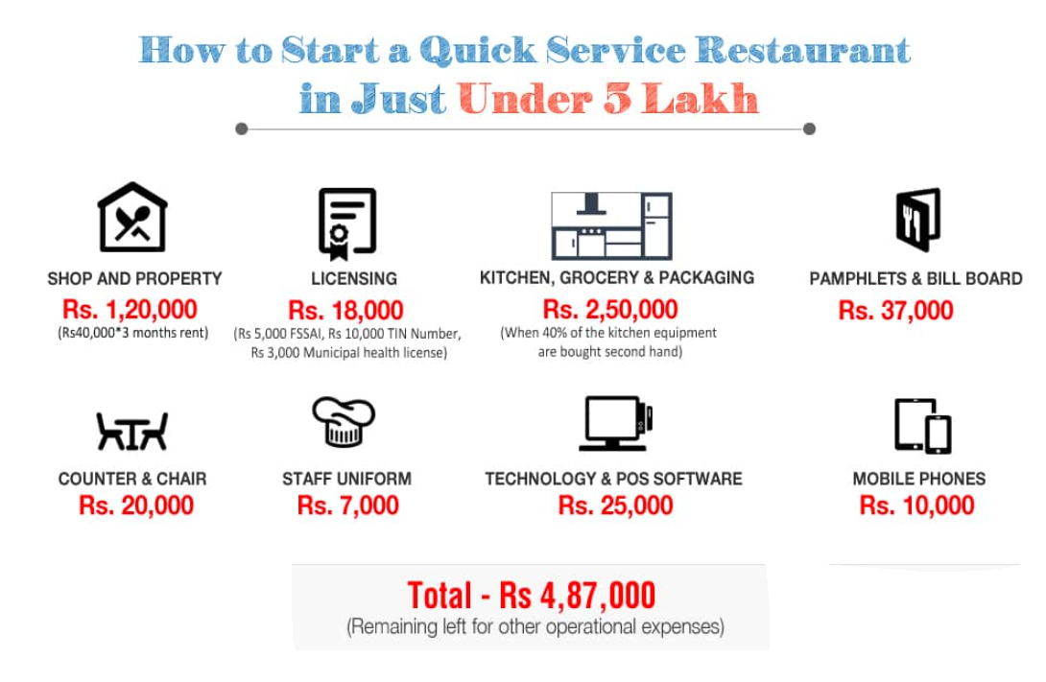
FINANCIALS
The main aim for setting up the financials for any business is to try to focus on cutting down the operating costs so as to increase the profit margin.
The primary costs should be reduced in order to put lesser burden on to the restaurant to recover the costs.
On the right, a illustrative chart is shown to cut down the setting up costs of a restaurant.

Slide 14
WAYS TO IMPROVE PROFIT MARGIN
Following points should be taken care of in order to improve the profit margin :
The COGS on Food is much greater.
The COGS on Beverage is lesser than general market standards.
Uneven distribution of expenses, higher operating expenses.
Contribution margin should be taken into account, in order to pay for the essentials required to run the business in the first place.
The key performing menu items should be taken notice of in order to yield more revenue per item.

Slide 15
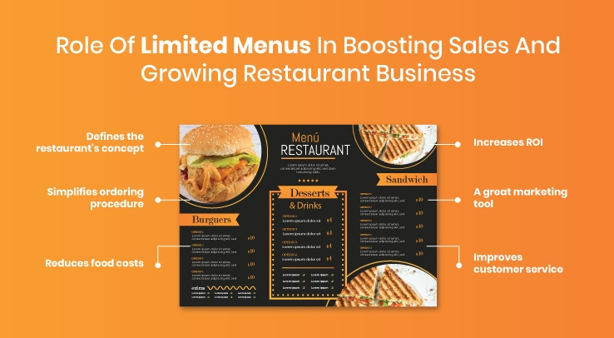
WAYS TO IMPROVE PROFIT MARGIN
Limited and Niche Menus

Slide 16
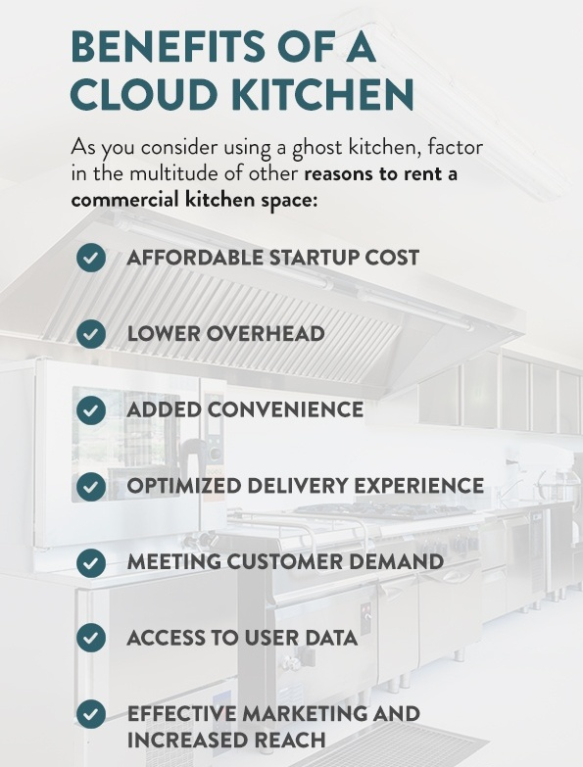
WAYS TO IMPROVE PROFIT MARGIN
Opting for CLOUD-KITCHEN
Owing to a multitude of benefits such as lower operating costs, low startup costs, reduced maintenance, and lower costs, cloud kitchens are today being considered the smartest way to run a restaurant business.
Cloud Kitchens vs. Traditional Kitchens
Traditional Restaurants Require More Capital and Administrative Hassle.
Traditional Kitchens Require More Staff.
Cloud Kitchens Have Lower Startup Costs.
Cloud Kitchens Have Higher Profit Margins.
Cloud Kitchens means to ‘Capitalize on Home Delivery Trends’.

Slide 17
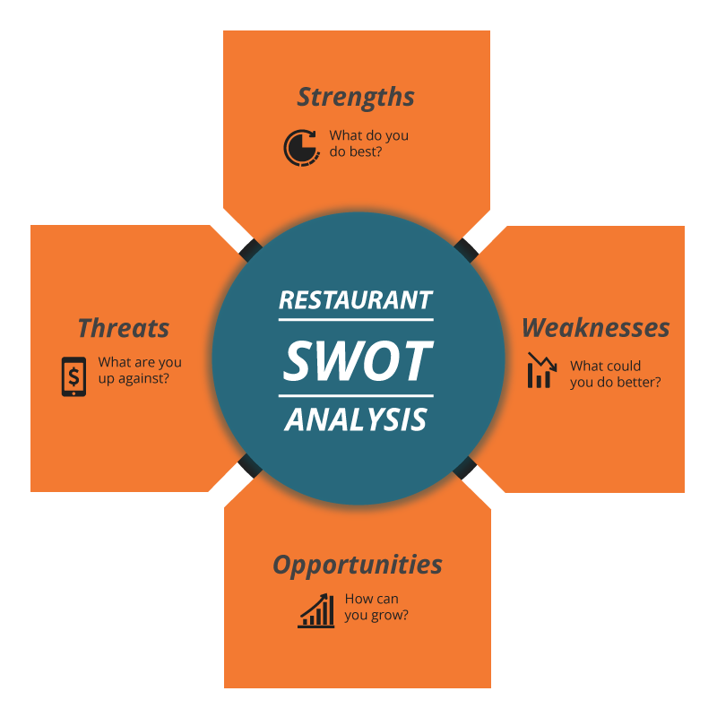
SWOT ANALYSIS
A restaurant may have the best ambiance or serve the most delicious appetizers in its locality.
But if it doesn’t keep tabs on its strengths and weaknesses or identify the opportunities and threats facing its business, the profitability may suffer.
That is where conducting a restaurant SWOT analysis can be the best defense against losing ground to competitors.

Slide 18

SWOT ANALYSIS – S & W
STRENGTHS
WEAKNESS
ABC Restaurant has its strengths lied in :
Premium Location
Pricing Power
Hygienic Food
Guest First Approach
Local Staff
Better Local Knowledge
Local Value Offering
Unique dishes and services
Close to Customer
Part of the Community
ABC Restaurant has its weakness lied in :
Existing competitors
Similar cuisine types
New openings happening
Higher supplier cost
High Operational cost
Uncontrolled COGS
Poor online presence
Not offering online ordering
No brand awareness
Limited menu items
Small market share
No marketing team

Slide 19
SWOT ANALYSIS- O & T
OPPORTUNITIES
THREATS
ABC Restaurant has its opportunities in :
Offering online ordering
Increase reviews
Social Media campaigns
Grow local brand
Introduce new menus
Reach wider audience
Run special offers – Combos
Control COGS – Reduce pricing
Increase loyal guests
Increase customer experience
Train staff
ABC Restaurant has its threats in :
Rising fixed prices
Declining Profit Margin
Forced closing
Loss of good suppliers
No sources of supporting investment
Bad ratings on review sites
Lack of trust from customers
Home delivery options
Economic downturn due to unforeseen pandemic

Slide 20

CHARTS

Slide 23
COMPETITOR ANALYSIS
--> review for " Dheekshi Snackies"
Good Wifi
Student Crowd
Customizable Food
Elaborate Menu
Family Crowd
Fresh Food
--> Negative reviews :
“Paneer undercooked. Very chewy the whole lot and the paneer should have been smaller pieces.”
“I have order schezwan paneer pasta..but I received some maggie masala pasta.. completely different order I received”
“No taste, just to fill the stomach mid night, won't recommend.”
Reviews of various other neighbourhood fast food restaurants.
--> review for Mc donalds
"Very nutritious and awesome taste“
--> review for "Morning Star"
Best in Service, Comforting Atmosphere, Best Staff, Clean and Hygienic Place, Great Veg Options, Delicious Taste
--> Services Provided :
Breakfast
Home Delivery
Takeaway Available
Outdoor Seating

Slide 24
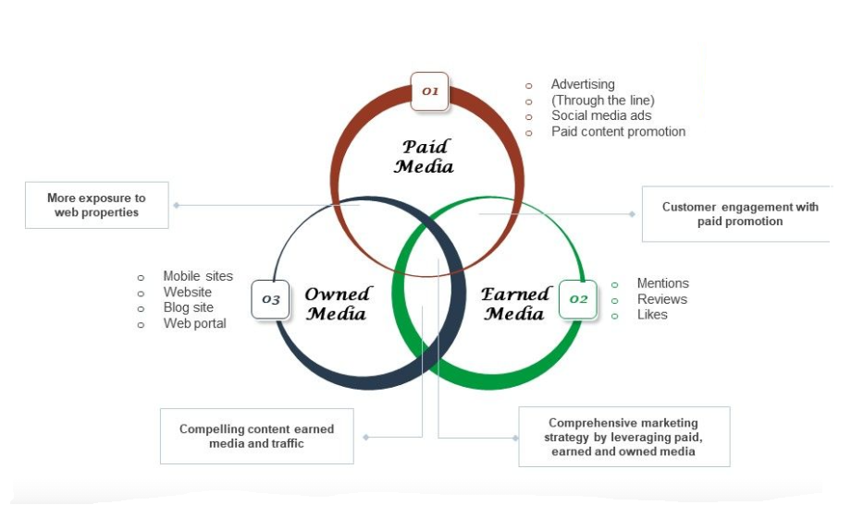
IN-DEMAND MARKETING STRATEGIES

Slide 25
CONCLUSION
The fast changing food trends should be taken note of time to time in order to track the pattern of customers’ choices.
Introducing Niche Menus, with Special Combo plans is the key to make it always interesting for the customers.
Dining area should be well sanitized and given the on-going pandemic situation, it should be a must to keep a check on social distancing.
Cloud Kitchens cut off on operational costs to a greater extent and can further be crucial to enhance the profits.
The COGS costing should be targeted to be kept minimal (around 30%), not much greater or lesser.
The COGS distribution for ABC Restaurant should be such that, the FOOD COGS should be reduced a bit but at the same time increasing the COGS of BEVERAGES to the current market standards.

Slide 26

PALLAVI RAJAN

